Slide 1
Detailed Design
Implementation of the ABC Using Modern Technology
Team: sdmay25-29
Presenters: William Mayer, Connor Hand, Zach Scurlock, Peter Hurd, Noah Butler
Client/Advisor: Dr. Alexander Stoytchev

Slide 2
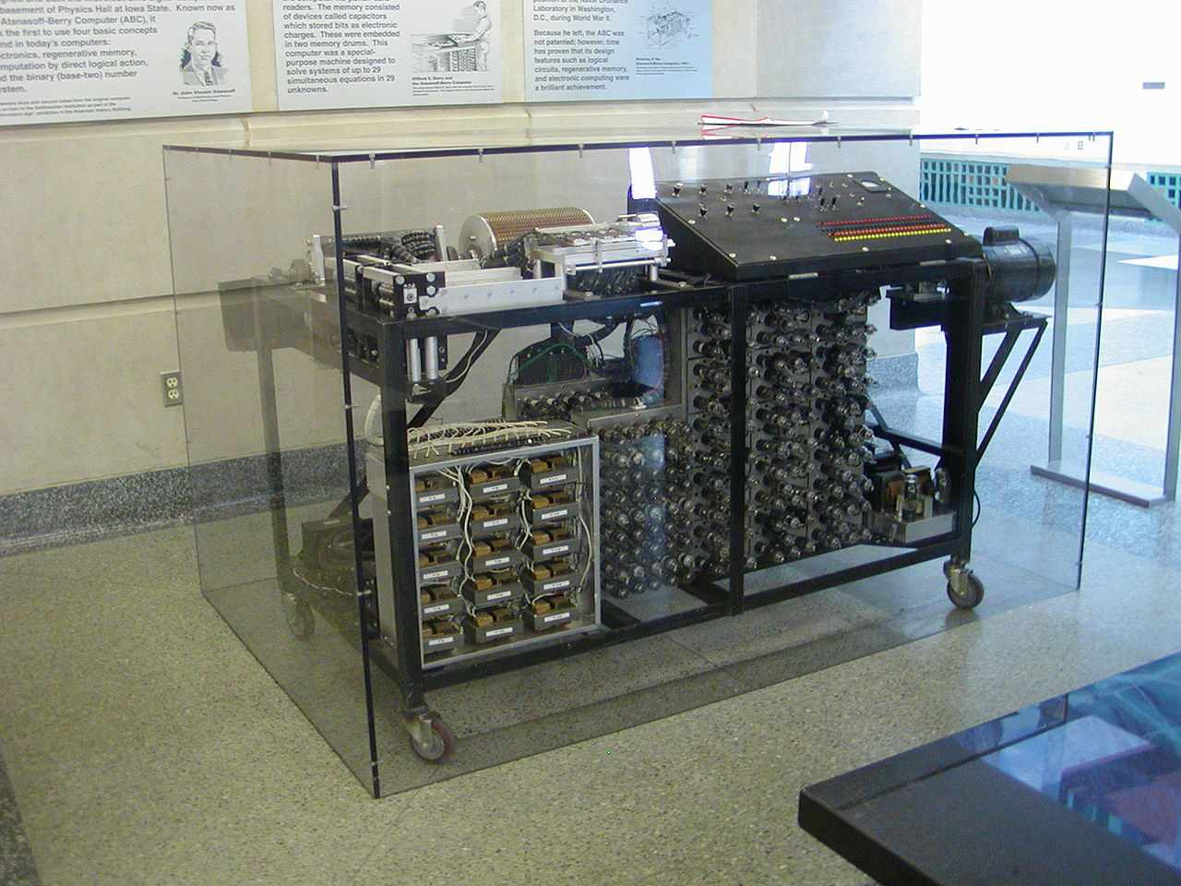
Project Overview
Implement the Atanasoff-Berry Computer using modern technology
The Atanasoff-Berry Computer (ABC) was the first electronic digital computer.
The purpose of the ABC was to solve systems of linear equations.
The ABC computer was constructed here at Iowa State and was destroyed in 1948.
We are recreating it as an educational demonstration of how it functioned.
The device that we make will be used as a learning aid to help teach students how computers function.
Replica ABC completed in 1997 by Iowa State Staff and students

Slide 3
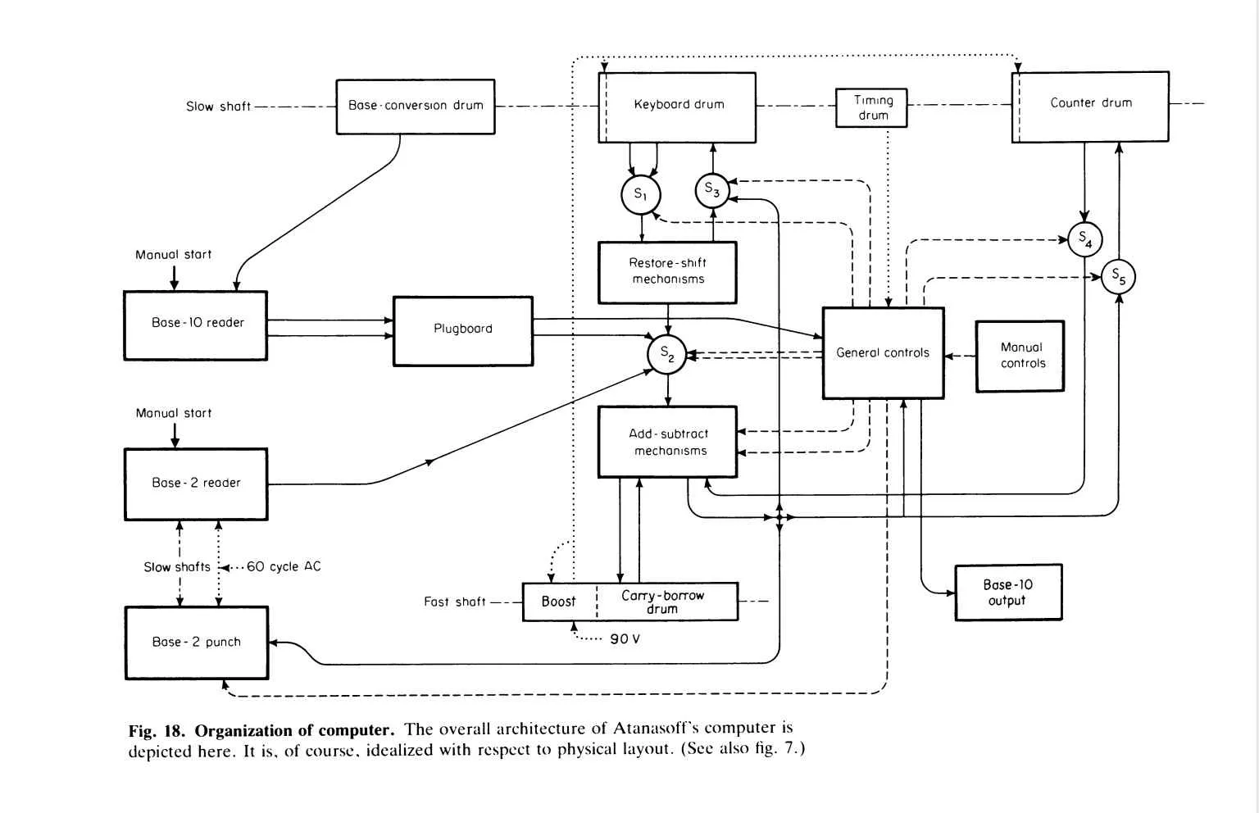
Design and Visuals
Our high-level design is based on the original’s design
The components we need to design consist of:
Add-subtract mechanism
Bit shifter
Base converter
Control unit
I/O
Other components, such as the various drums, can be implemented using simple components at our disposal (i.e. memory chips)
Block diagram representation of the ABC (Burks and Burks, 1989)

Slide 4
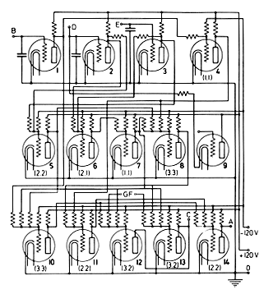
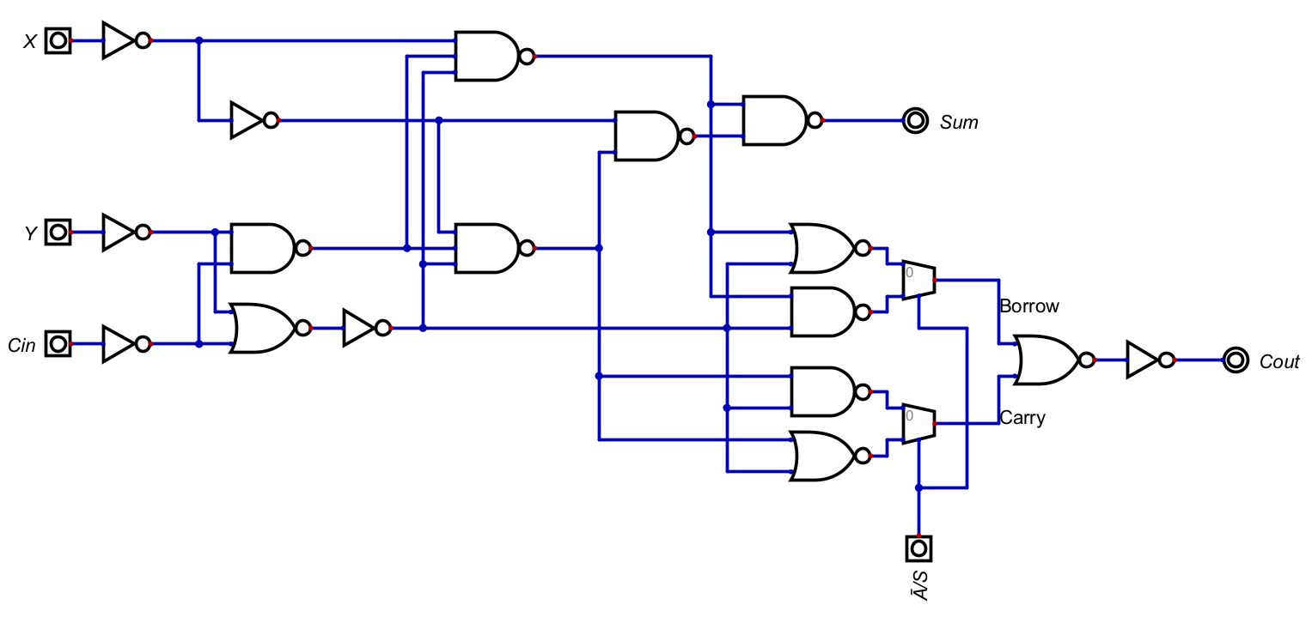
Adder-Subtractor Design
The adder-subtractor module is the first component we finished designing
Modern digital logic circuit was designed based on the logic used on the original ABC with vacuum tubes
Vacuum tube circuit diagram (Atanasoff, 1940)
Our modern version of the vacuum tube circuit

Slide 5
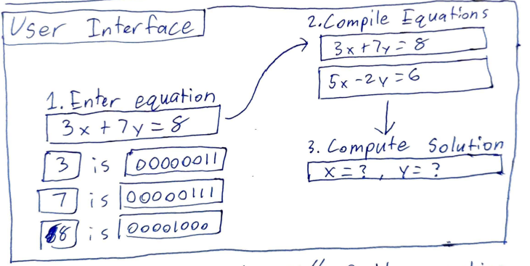
Functionality
User Input: A linear set of equations up to 29 integer coefficients and a constant
Response: Visualizes the steps of calculations through LEDs
Output: Correct solution to users input
Function: Will use the same logic as the original ABC, but other components, like I/O, must be modernized
High level UI initial design by Peter Hurd
Notes:
Joey

Slide 6
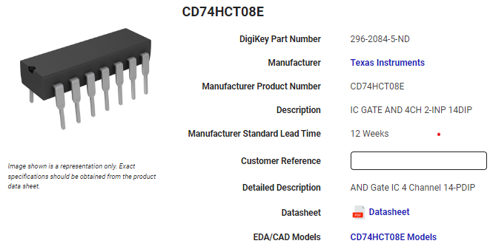
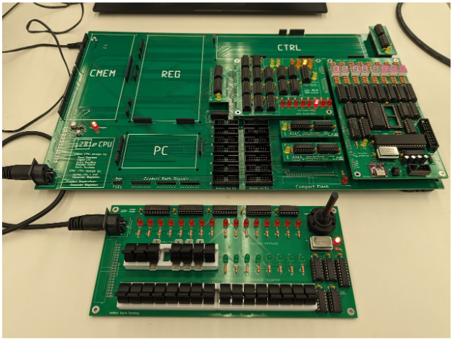
Technology Considerations
Emphasis on “Modern Technology”
Modern digital logic circuits (gates, combinational logic, memory, etc.)
Integrated circuits vs. FPGA implementation
Final design implemented on a Printed Circuit Board (PCB)
Design must serve educational purposes!
TI integrated circuit to implement AND gates
Example PCB design from i281 team

Slide 7
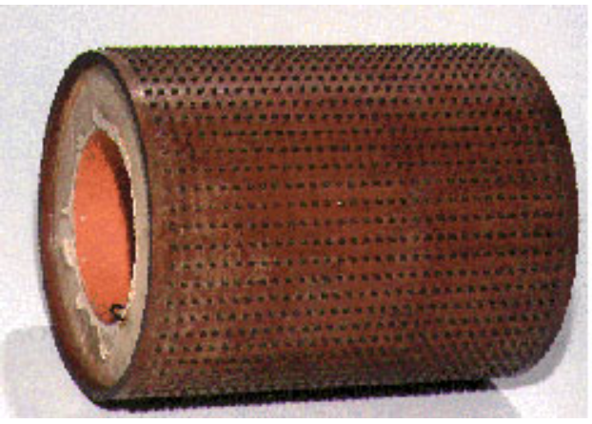
Areas of Concern
Reverse engineering specific components
Module-level implementation depends on functional understanding
Limited timeframe within Senior Design course schedule
We believe our design path will satisfy our project requirements
Memory drum component of ABC

Slide 8
Conclusion
Our goal is to implement the ABC using modern technology
Our design is based directly on the original’s with what information we are able to find
We intend to visualize how the computer is working to the user
We have few concerns on time constraints

